Slide 1
K8s
Deployment

Slide 2
Agenda
Deployment
Service
Ingress
Volumes
ConfigMaps
Secrets

Slide 3
K8s. Deployment
how pods will be created
how will they run and communicate with each other

Slide 4
K8s. Deployment file. Demo

Slide 5
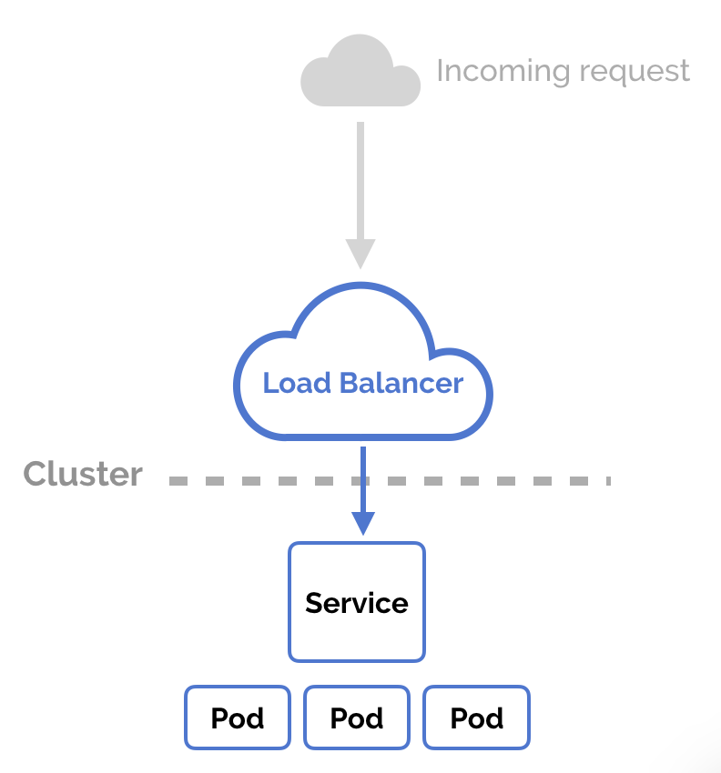
K8s. Service
make possible accessing multiple pods
works as Load balancer

Slide 6
K8s. Service. Demo
Add service to the deployment

Slide 7
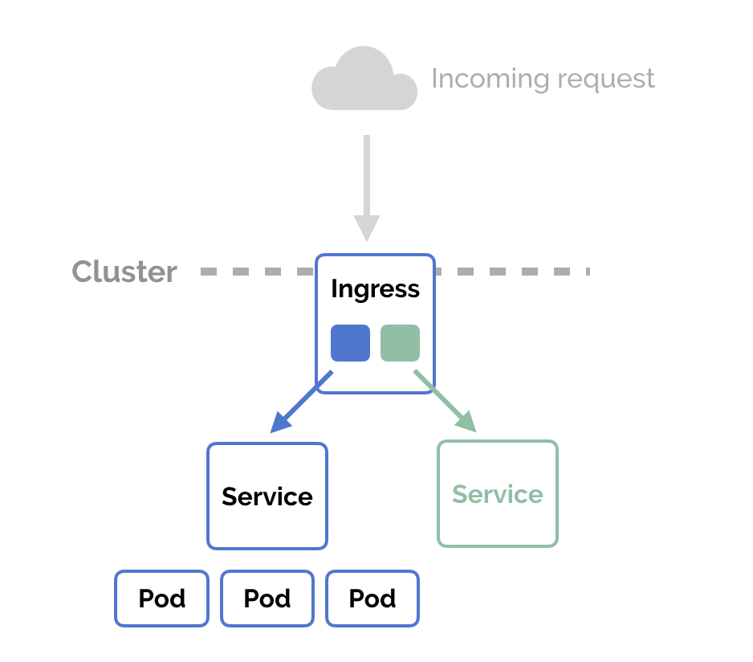
K8s. Ingress
exposes HTTP and HTTPS routes from outside the cluster to services within the cluster
has rules
types of Ingress
Single Service Ingress
Simple fanout
Name based virtual hosting
TLS

Slide 8
K8s. Ingress. Demo

Slide 9
K8s. Volumes
Volume ~= directory
volume type
comes from
how use
Contents
Examples
hostPath
persistentVolumeClaim
nfs
iscsi
secret
gcePersistentDisk
awsElasticBlockStore

Slide 10
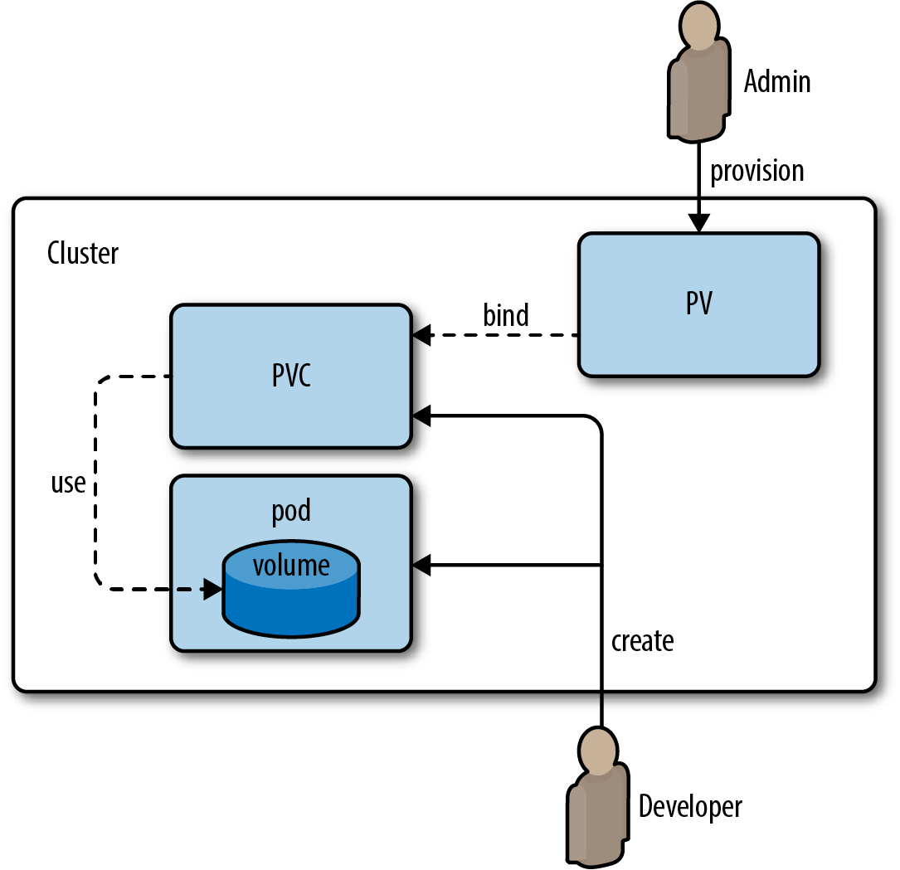
K8s. persistentVolumeClaim and persistentVolume
(PV) abstraction for storage
(PVC) request for storage

Slide 11
K8s. persistentVolumeClaim and persistentVolume
Demo

Slide 12
K8s. ConfigMaps
pass configuration details as key-value pairs
Create
From literal values
From files

Slide 13
K8s. ConfigMaps
Demo
Create ConfigMap
Attach ConfigMap

Slide 14
K8s. Secrets
share sensitive information like
passwords
tokens,
keys in the form of key-value pairs
Create
Use command
Use manifest

Slide 15
K8s. Secrets
Demo
Create secret using command
Create and use secret declaration

Slide 16

K8s. Helm
Package manager
Template manager
One app inside:
All manifests
All values in separate file
Versions

Slide 17
K8s. Helm
Two part
The client (CLI)
The server (Tiller)
Concepts:
Chart
Release
Repository

Slide 18
K8s. Helm. Benefits
Boosts productivity
Reduces duplication & complexity
Simplifies deployments

Slide 19
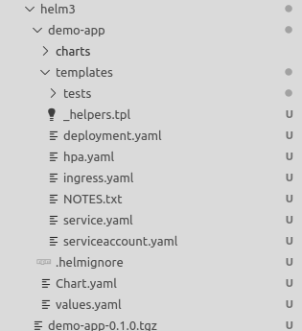
K8s. Helm. Repo
.helmignore
Chart.yaml
Values.yaml
Charts
Templates

Slide 20
K8s. Helm. Repository of charts
Simple http server with index.html (yaml format) and folder with charts archives
https://example.com/charts/alpine-0.1.2.tgz
Realization
Google Cloud Storage
JFrog Artifactory
GitHub Pages example
Ordinary web servers
ChartMuseum Repository Server

Slide 21
K8s. Helm. Demo
Create app
Deploy app
Set parameters

Slide 22
K8s. To read
https://kubernetes.io/docs/tutorials/
https://helm.sh/docs/intro/install/

